Slide 1
Unpacking the Factors Influencing Election Outcomes: A Comprehensive Analysis
Kecheng Ye

Slide 2
Introduction
• Elections are the foundation of any democratic system, and their outcomes have a significant impact on the governance and future trajectory of a nation.
• Concerns and issues regarding elections have emerged over the years, including voter suppression, election security, and money in politics
• It's important to understand what factors contribute to election results
• Factors that can influence election results include income, age, food, race, marriage, education, and votes & parties
• Analyzing the interplay between these variables can provide insight into predicting election outcomes
Notes:
Understanding the factors that impact the election outcome is crucial for the citizens and society. This project is to help the reader to understand the factors that influence the election outcome by analyzing different factors such as marriage, income, education, and so on. The team first defines the top features that could significantly impact the election outcome based on different models to cover multiple aspects of the winning parties. Then, further model analysis is conducted with real-world recorded and text data to deeply understand the characteristics of the winner of each election and determine the factors that contribute to the outcome. The team utilizes different methods throughout the analysis, such as random forest, KNN clustering, hypothesis testing, and multiple regression models, to define the factors affecting the outcome. The results show that education, marriage, and race are indeed more critical factors than others. In addition, other factors such as income and employment also can contribute to the election outcome.

Slide 3
Analysis & Methodology
Dataset Gathered:
US Census and Election Results (2000-2020) from Kaggle. Fundamental variables include individuals' annual income, annual total family income, age, gender, marital status, race, citizenship status, language spoken at home, education level, and employment status at the individual level.
Dataset Cleaned:
Dataset columns are renamed such that reader will be easier to understand the features. Missing values are dropped due to vast time range, it will not be feasible to replace them.
Notes:
Our datasets are scraped and merged from the US Census website, MIT Election Data, and Science Lab. We first dropped all the null variables and deleted some features that contained too many null variables. Then, our team found that there exist features that are highly correlated with other features, and our team decided to drop them.

Slide 4

Statistical Models:
Uncover patterns and relationships within the data, make predictions about various outcomes, and ultimately gain a deeper understanding.
Our models：
Logistic Regression & LDA & QDA Random Forest KNN Clustering GBM & SVM XGBoost LASSO

Slide 5
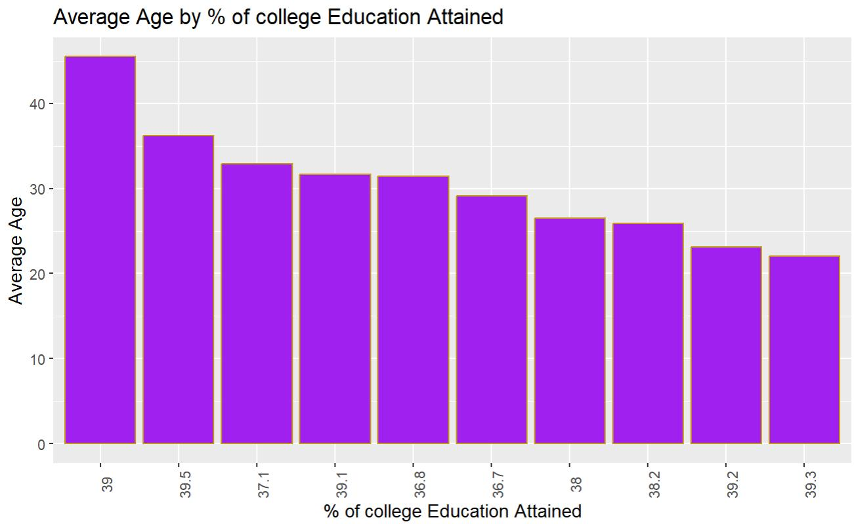
Some fundamental variables pattern and correlation: We can see that the majority electors have average age from 40 to 50.
EDA
CONTENTS
1
2

Slide 6
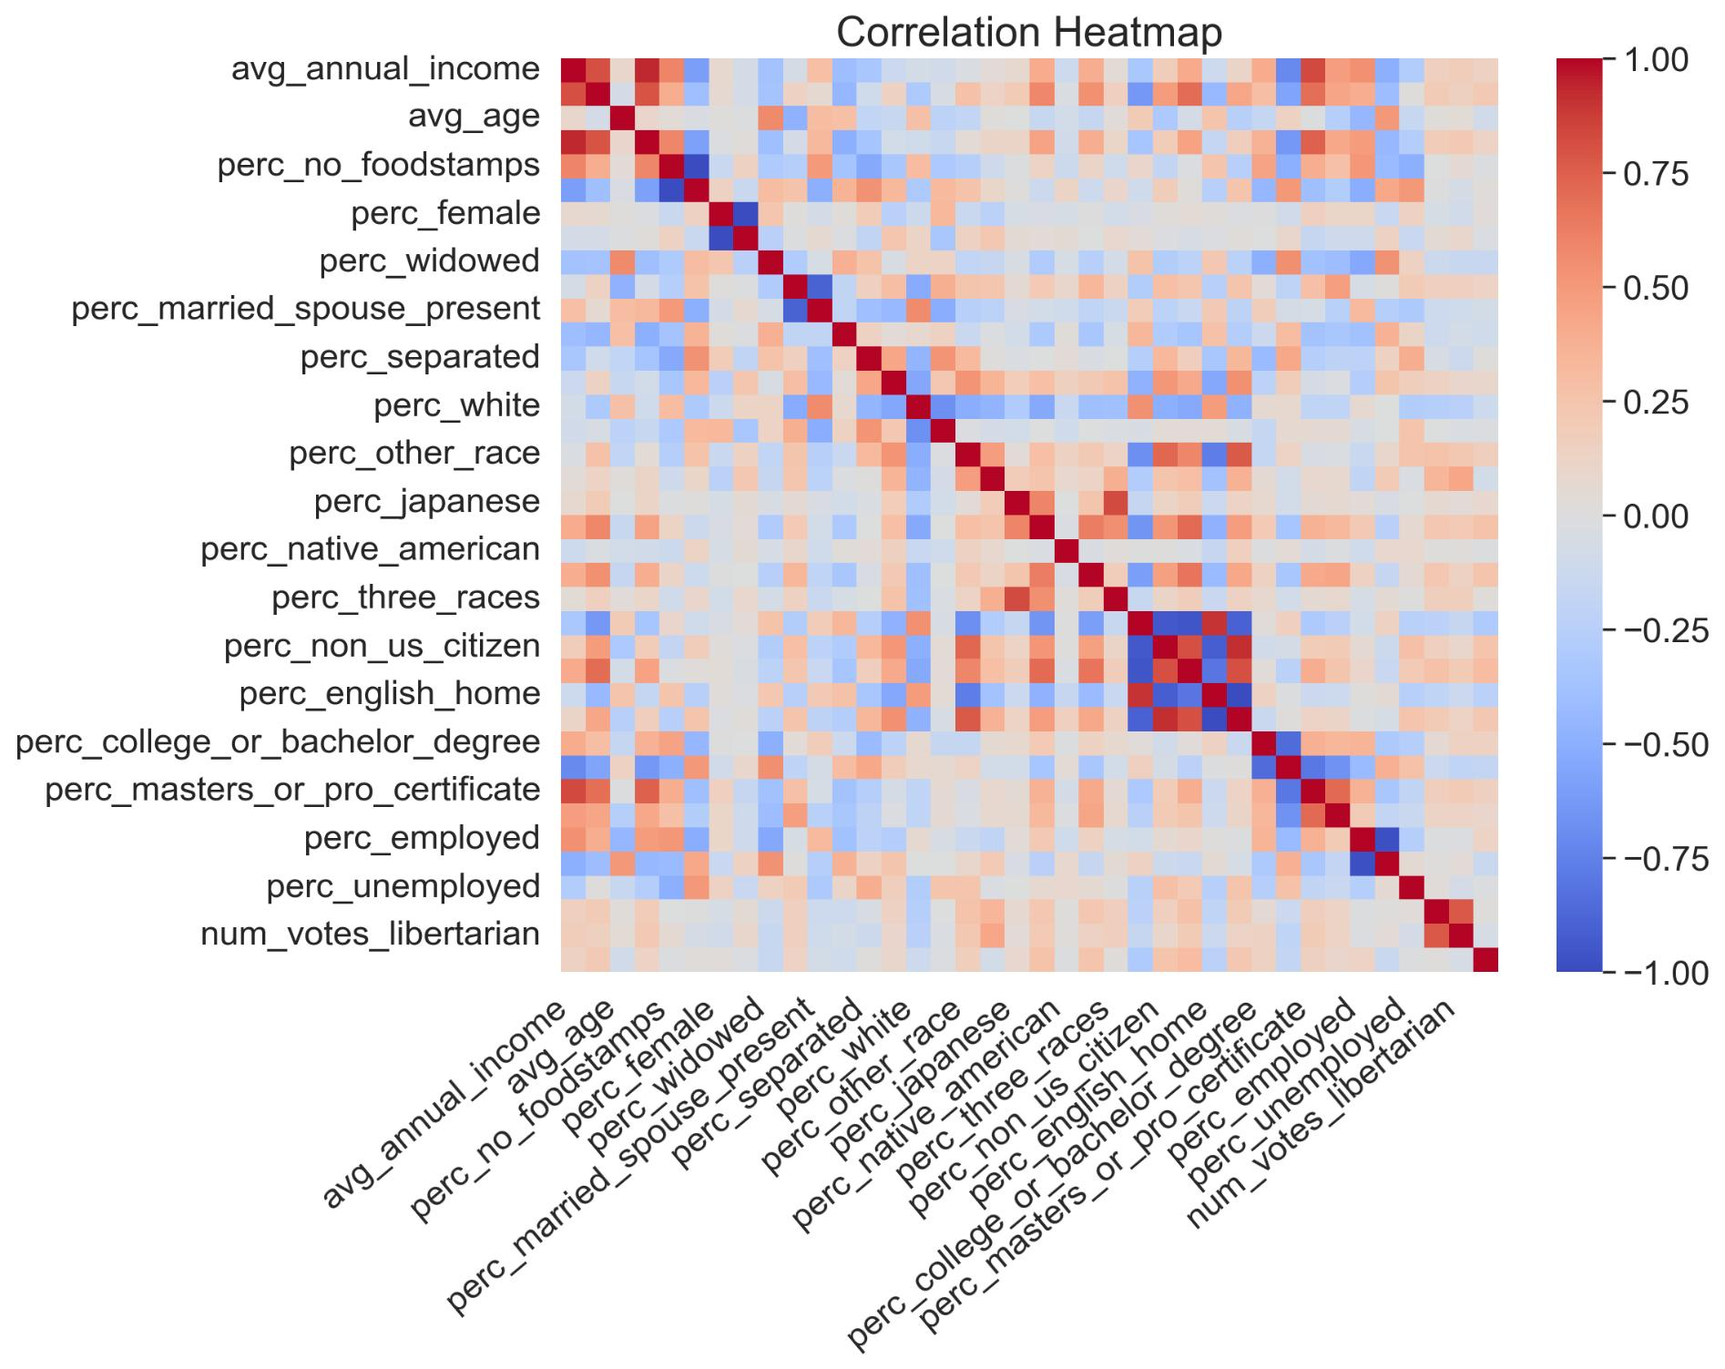
The Overall pattern and correlation among features
EDA
CONTENTS
1
Few of the features shows strong correlation to each other. In addition, the response feature is the winner, the categorical variable.
2

Slide 7

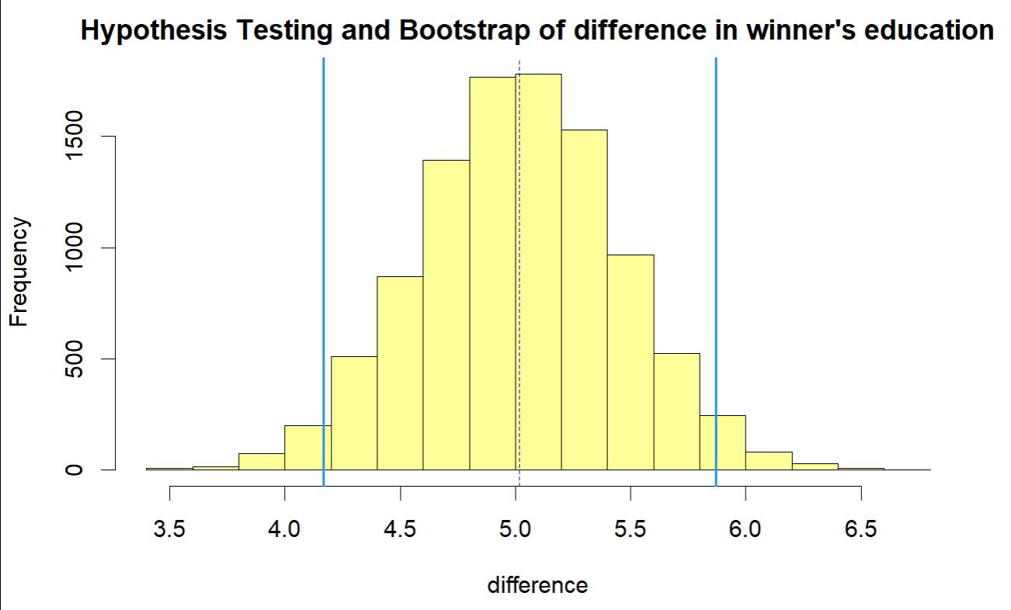
H0: The mean education for both party winners is the same
Ha: The mean education of Republican winner is higher
Hypothesis
Testing
1
P value < 0.05
2
Notes:
Hypothesis testing is a statistical method used to determine whether a hypothesis about a population is true or false based on sample data. In this research, we also utilize the bootstrap method for determining if the winning parties have a difference in certain education levels.
Our research team decided to use Hypothesis testing to find out if there is a difference in terms of the level of education of the target supporters of the two parties. Our null hypothesis is that the mean high school or lower education for both parties’ supporter groups is the same. Meanwhile, our alternate hypothesis is that the mean education of the Republican supporter group is higher.
As we can see in Figure 5 from the bootstrap difference, the result as well as the p-value smaller than 0.05 both provides us with strong evidence to reject the null hypothesis and make the conclusion that the support group of Republicans has more education in or lower high school level education. This means that overall winners from the Democrat parties have higher education levels than the Republican winners.

Slide 8
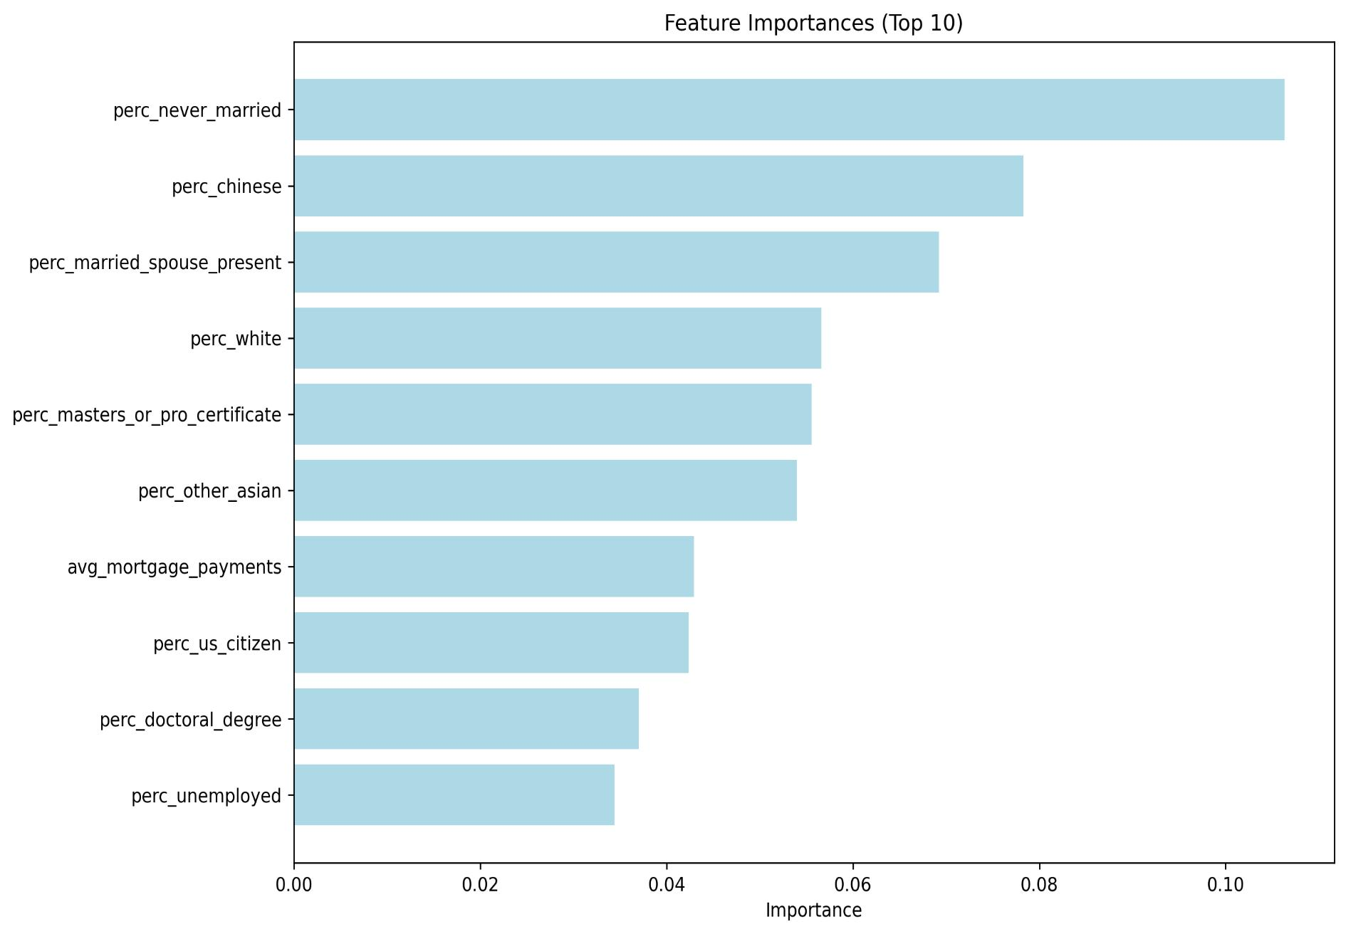
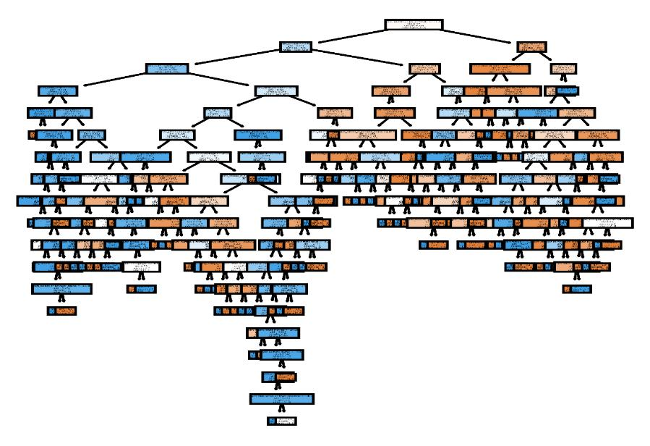
The results show that the top 10 feature that contribute mostly to election results are marriage, race, citizenship, mortgage payments, doctoral degree, and employment.
Modeling:
Random Forest
1
2
Notes:
In our analysis of the county-level voting patterns for Democrats and Republicans in the US presidential elections, the top ten features identified through the importance plot are characterized by a wide range of values and varying degrees of importance. The percentage of individuals who have never been married is the most important feature, with an importance score of 10.80%, followed by the percentage of Chinese and White populations (7.68% and 5.51%, respectively). The remaining features have importance scores ranging from 3.45% to 6.80%.
The top features that contribute most to the model's accuracy are those most strongly associated with the demographic and socioeconomic characteristics of the county population. For example, the percentage of individuals who have never been married and the percentage of married couples with a spouse present is likely to be strong predictors of voting patterns, as they may reflect differences in cultural or social values. Similarly, the percentage of individuals with higher education levels or higher average mortgage payments may reflect differences in economic priorities or preferences.
Comparing the feature importances can help to identify common patterns or differences, which can help to inform policy or campaign strategies that target specific demographic or socioeconomic groups.

Slide 9
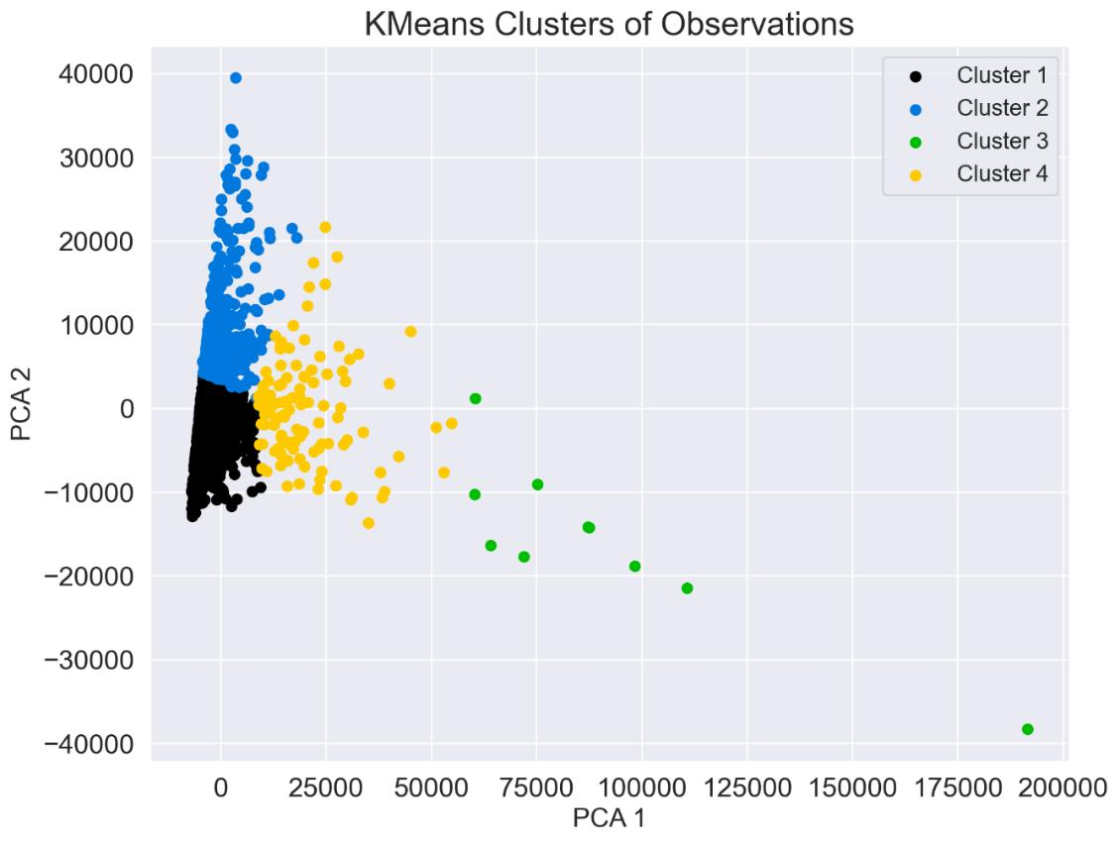
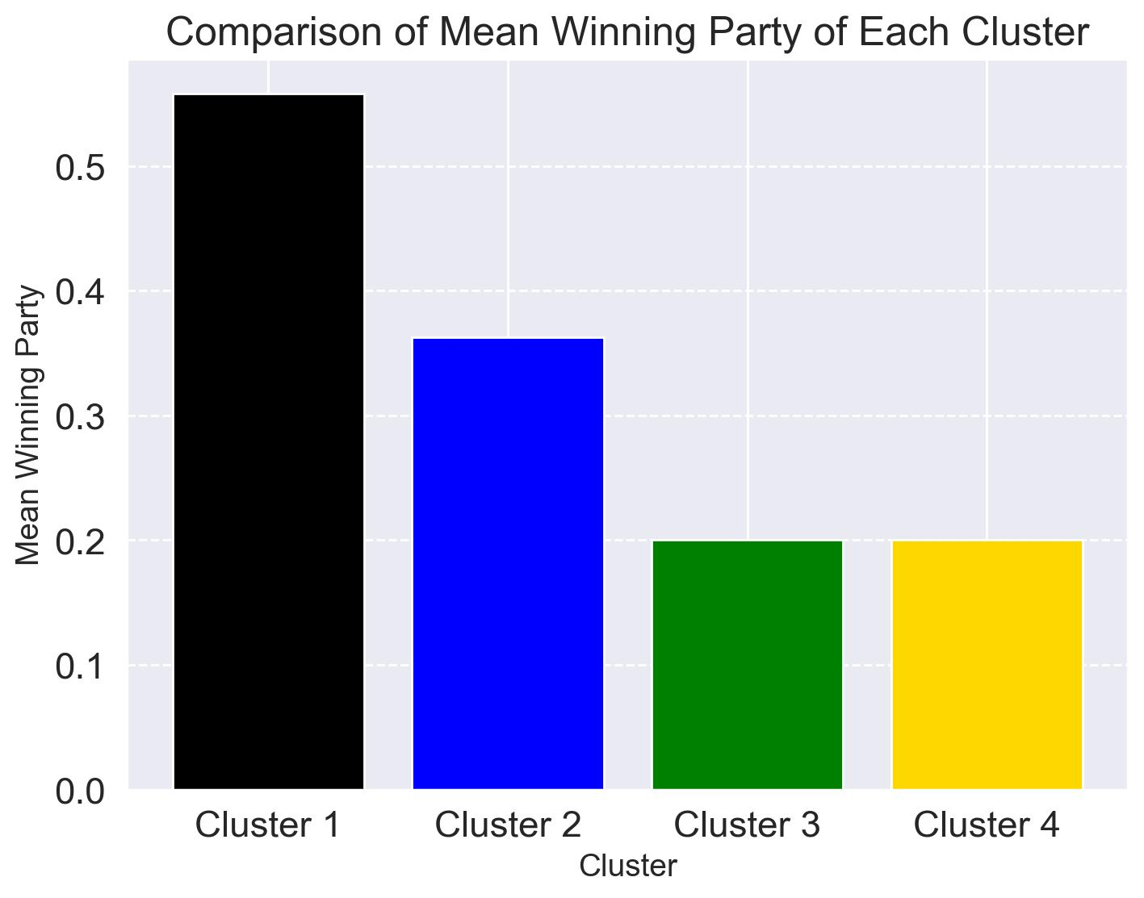
We can see that the cluster group 3, and 4 are balanced which cluster group 3 only contains 9 observations. • Here we can see that the cluster one group’s average winning party are significantly higher than the other three cluster group.
Modeling:
KNN-Clustering
1
2

Slide 10
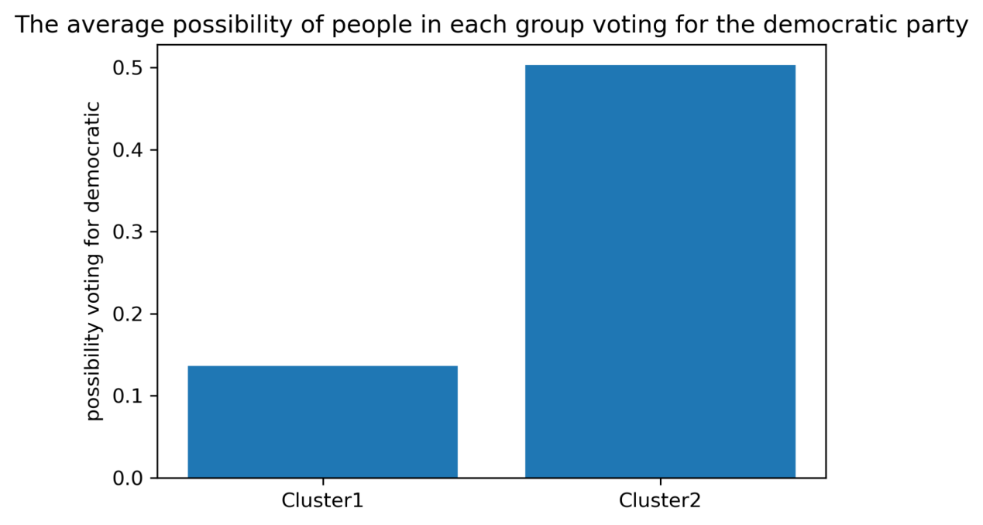
Our research team finds that people who have been put into Cluster 2 are significantly more likely to vote for Republicans compared to people who have been put into Cluster 1.

Slide 11
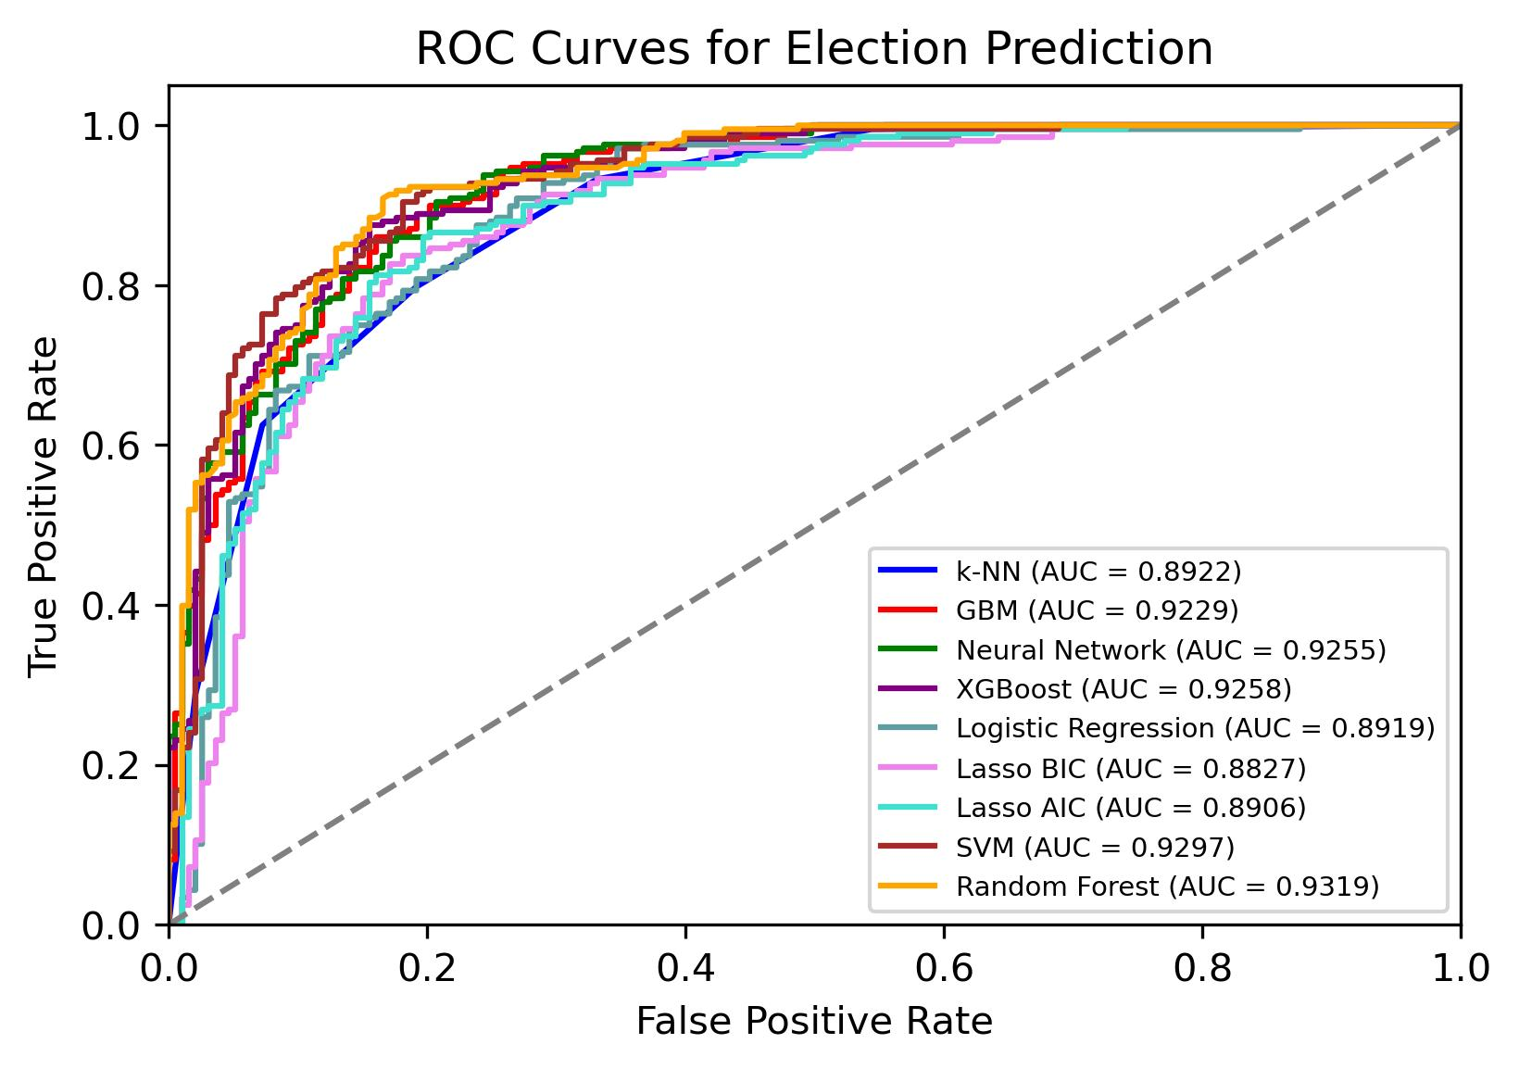
We can see that Random Forest Model has the best performance in predicting factors that contribute to selection method. GBM, XGBoost models also have a relatively good performance. While KNN, logistic regression, and Lasso models has relatively low performance.
Models Comparison
1
2
Notes:
According to Figure 6 and Table 1, we can see that the random forest has the best performance than others. However, the difference among the models is not too obvious in terms of AUC shape and score. Both Figure 6 and Table 1 shows that every machine learning model we tested on our test set is getting a decent AUC performance, and this is because we have a large dataset that contains many features and observations that contain enough information to do the classification.

Slide 12
Conclusion
We have found that the key features that affect election outcome are actually“Never Married”&“Race Info”.
• We find that both supervised and unsupervised method are giving us a great result in term of predicting our target variable.
• There are differences among Republican and Democrat Winners: Education, Age, and some other features
• We have found that our dataset contains many features with strong correlation, and we removed them.
• Random Forest are having a better performance than XGBoost, which could because of our data set does not contains many features after data cleaning. Features such as foodstamps, family incomes, home languages do not necessarily provide a change to the election outcome.
• The combinations of different features have more to contribute to the election outcomes than single feature.
Notes:
Throughout this research, the team aims to unpack the factors that have an impact on the election outcome by making an analysis of different factors such as marriage, race, income, education, and so on. The team has successfully conducted many supervised learning models to cover multiple aspects of the winning parties. Then, the comparisons among the analysis models are conducted with real-world data.
The research has found that the key features that affect election outcomes are actually marriage and race. In addition, education, marriage, and race are also crucial factors that contribute to the election outcome. This means that there are differences between Republican and Democrat Winners concerning their education, race, and marriage. However, the team also thinks that there are many features such as food stamps, family incomes, and home languages that do not necessarily provide a change to the election outcome. The importance of these features is not as crucial as the major ones from above. The combinations of different features have more to contribute to the election outcomes than a single feature.
For future works, more features can be found and analyzed since there could be other potential external factors that can have an impact on the outcomes, such as public opinions and big world events. Therefore, future analysis on more factors with more data can be conducted utilizing different models to understand the election outcomes more thoroughly.

